Slide 1
Introduction to RAG
Anastasiia Havriushenko
ML Engineer
Keep in touch

Slide 2
Overview
Text embeddings
LLM basics
RAG architecture
Demo

Slide 3
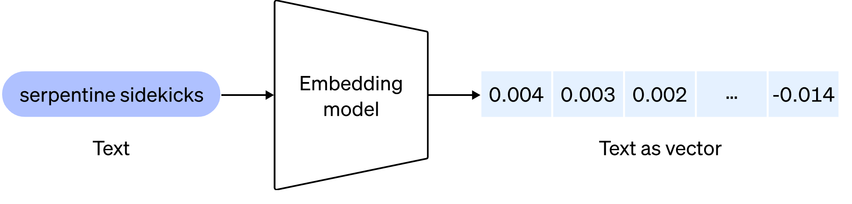
Vector embeddings
embedding
Python examples: word2vec, text2vec
Image: OpenAI

Slide 4
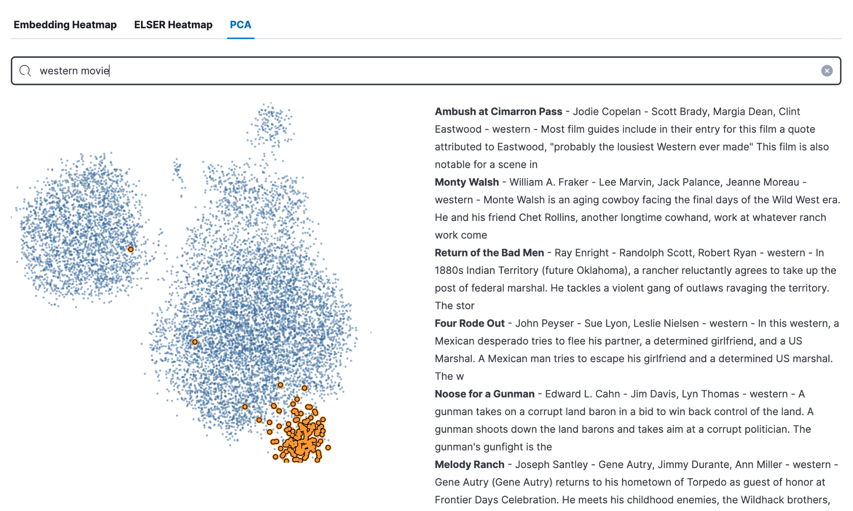
Embedding visualization

Slide 5
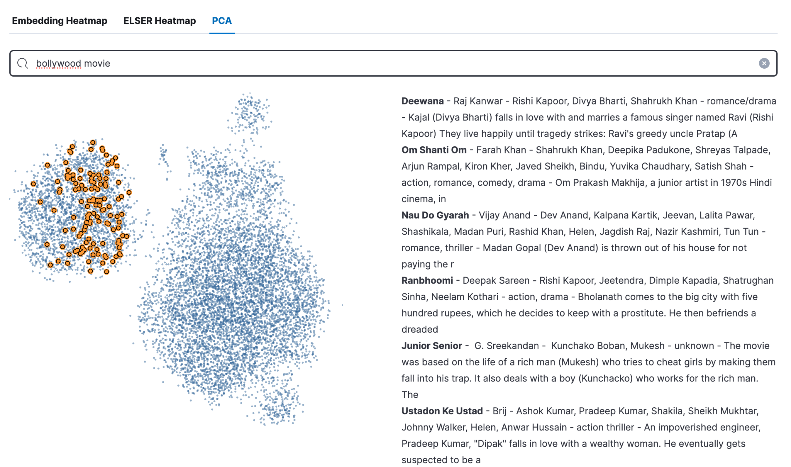
Embedding visualization

Slide 6
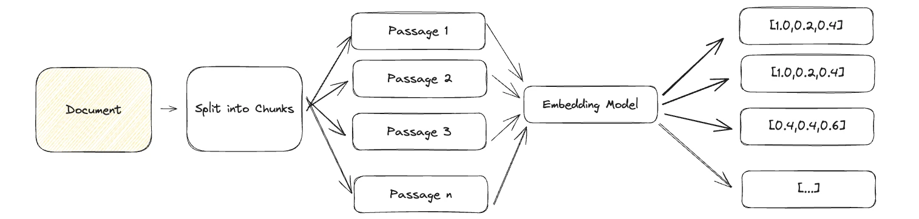
Vector embeddings

Slide 7
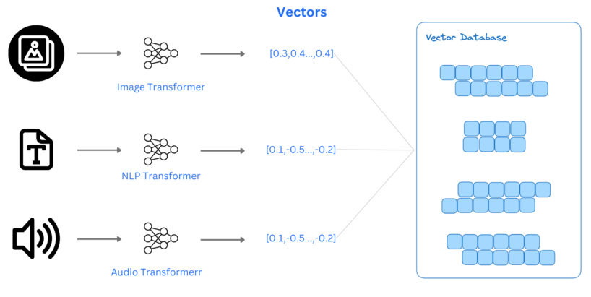
Vector embeddings

Slide 8
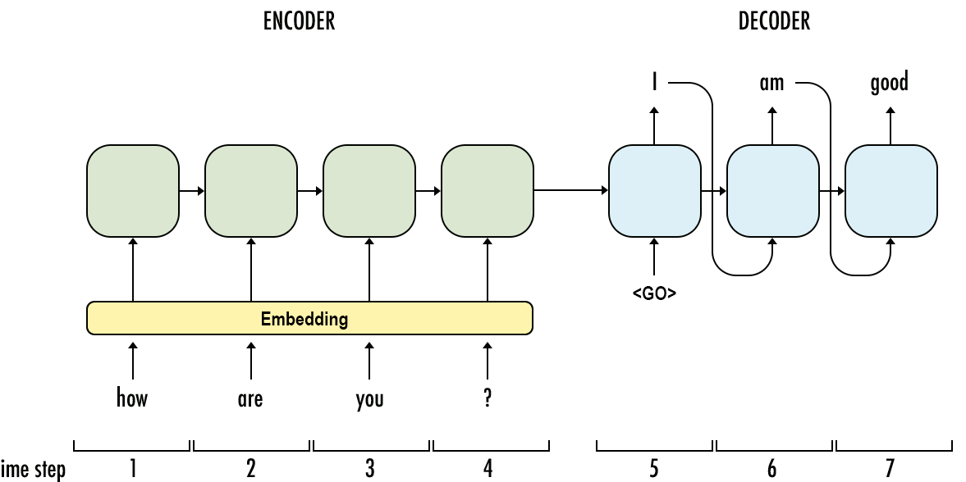
NLP design

Slide 9
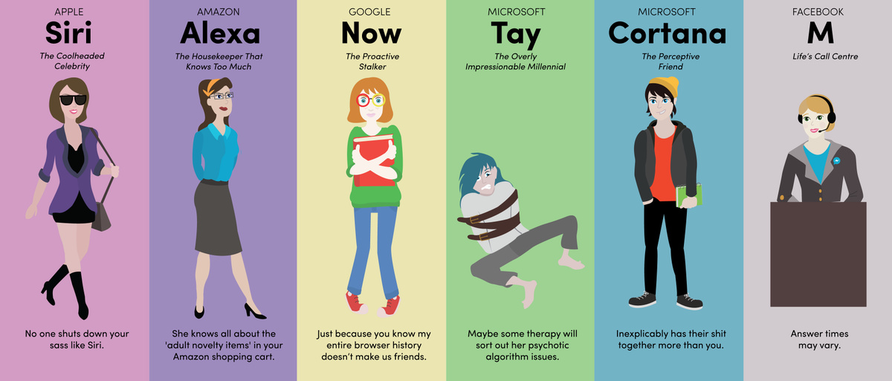
Evalution of Chatbots

Slide 10
Common LLM challenges:
Hallucinations
Lack of domain knowledge
Frozen parametric knowledge
Privacy concerns
Expensive to (re)train

Slide 11
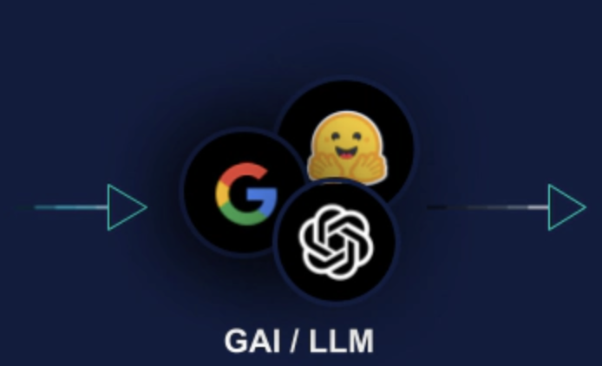
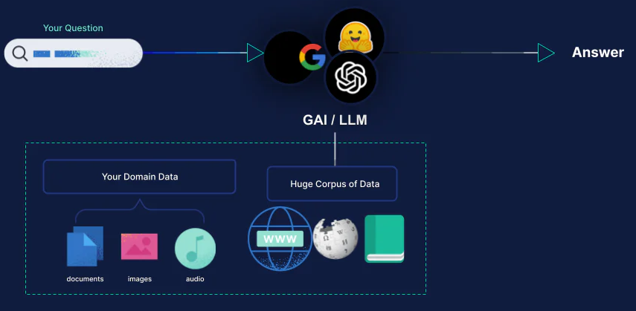
Domain Specific Pre-Training for LLMs
More info

Slide 12
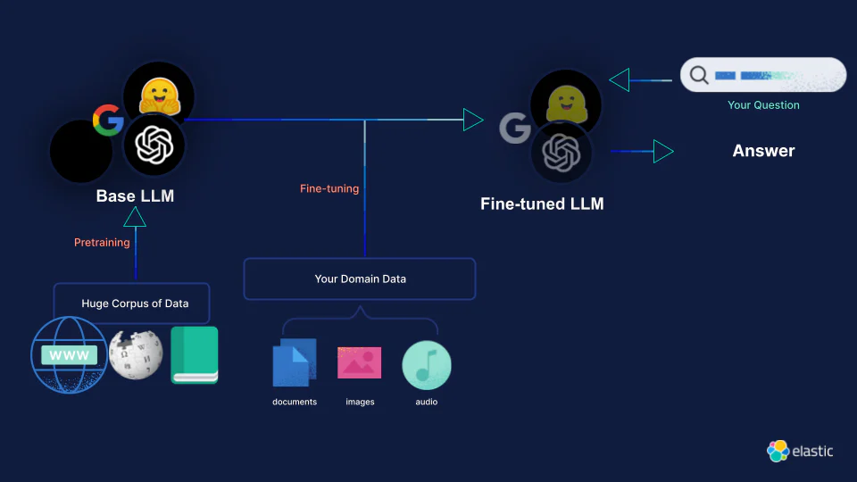
Domain Specific Fine-Tuning for LLMs
More info

Slide 13





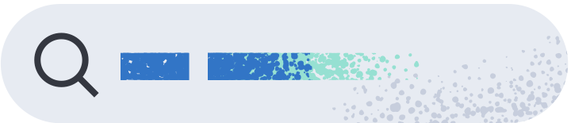






RAG Elastic workflow
Your Question
Your Question
The Right Answer
+
Context Window
GAI / LLM
Pretrained on open data
Your Business’s Data
Retriever
documents
images
audio
More info
Notes:
We power this with something we call the Elasticsearch Relevance Engine.
Most downloaded / used search engine?
Most downloaded / used vector database?

Slide 14
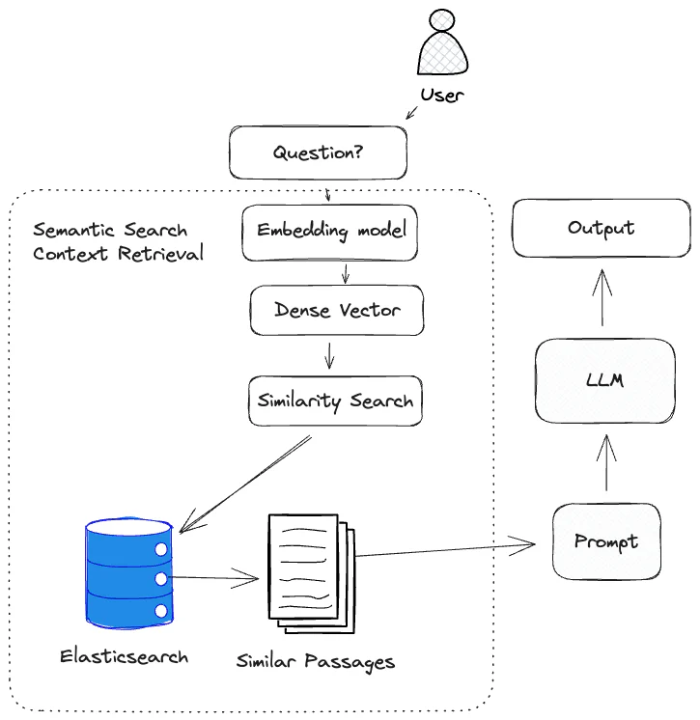
RAG architecture

Slide 15
Demo
Link code
Link app

Slide 16
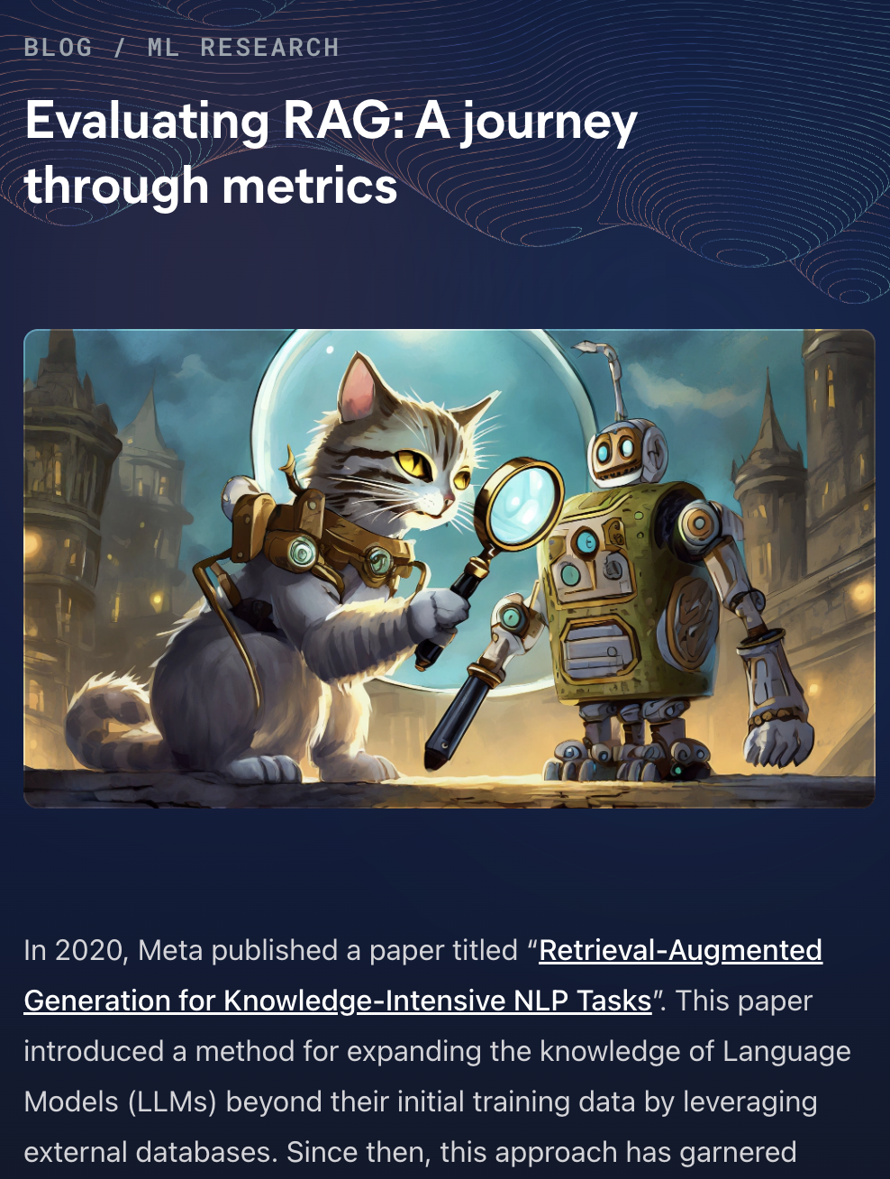
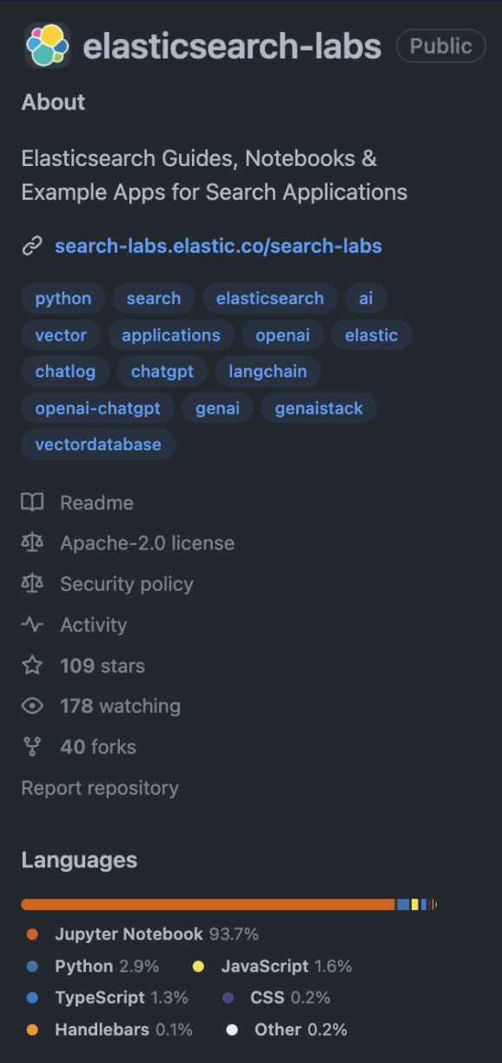

Resources for developers
Generative AI
ML Research
Vector Search How-Tos
Integrations
Lucene
New!
elastic.co/search-labs
github.com/elastic/elasticsearch-labs

Slide 17
Thank you!
Questions?

